Slide 1
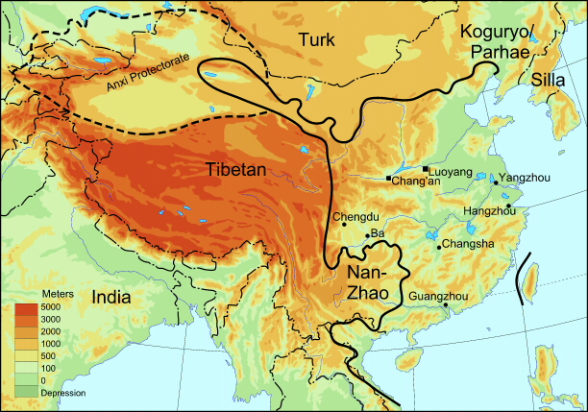
SUI DYNASTY (581-617) & TANG EMPIRE (618-907)

Slide 2
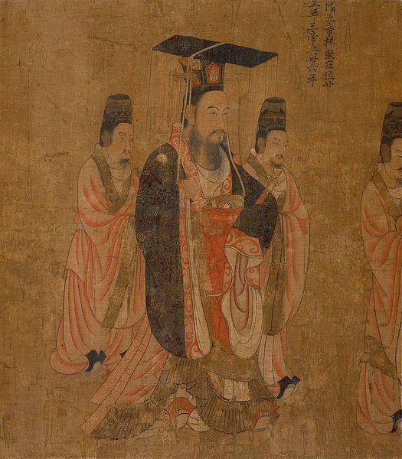
Yang Jian 楊堅(541-604)
General with a Chinese surname, serving the Northern Zhou (Xianbei) ruling house, which had taken over the Northern Wei four years earlier.
Yang ousted his daughter’s son from power and slay 59 princes of the Zhou family to found the Sui dynasty (581-617).

Slide 3
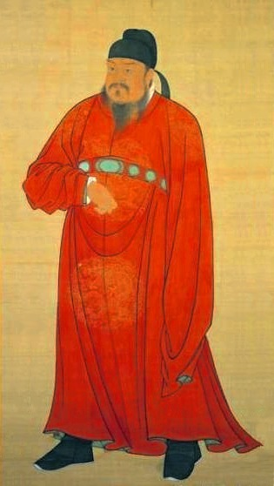
Li Yuan 李淵(566- 635)
First cousin to the second Sui emperor, became Tang Gaozu (r. 618-626) the first Tang ruler.
Official histories state that he was reluctant to take the throne, but historical evidence records a much more bloody struggle.

Slide 4
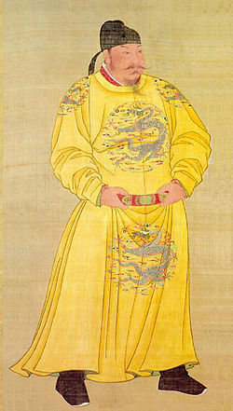
Li Shimin 李世民 (598-649)
Li Yuan’s second son Li Shimin became the ambitious second emperor Tang Taizong (r. 626-649).
Taizong took the title “Emperor” and “Heavenly Khan” to rule over both sedentary and nomadic subjects.

Slide 5
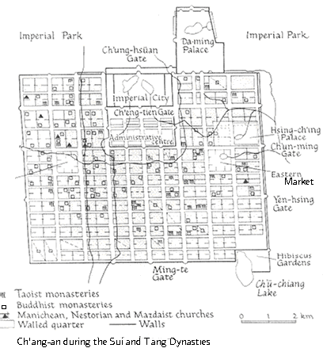
Early Tang: Strong Central Court; Cosmopolitanism
Court open to cultural influences from outside, particularly Central Asia and India.
Tang still the cultural model and an attraction to other settled societies in East Asia.
Image source: Paul Halsall, Internet Sourcebook

Slide 6
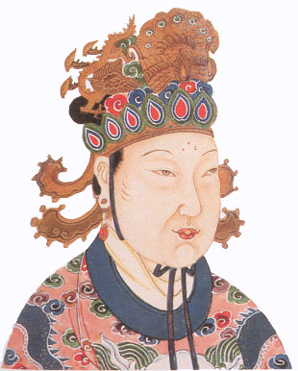
Empress Wu (Wu Zetian 武則天) (ca. 625-706)
Concubine of the third emperor Gaozong and founder of the “Zhou” dynasty. After taking the throne, she proclaimed herself Emperor Shengshen, the first woman ever to use the title of “emperor.”
Under Empress Wu government service gradually became the most prestigious career in the Chinese Empire.

Slide 7
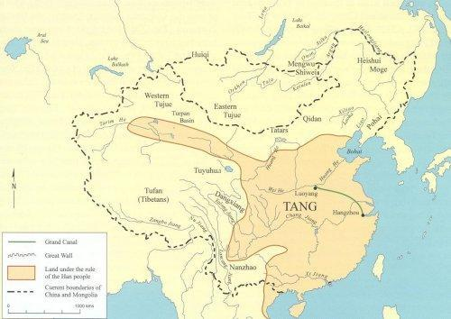
Mid-Tang Crisis
An Lushan Rebellion (755): widespread rebellion, launched by powerful Turkish frontier commander An Lushan 安祿山(703-757). This revolt contributed to the gradual but inevitable decline of the Tang.

Slide 8
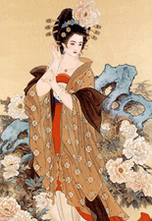
Yang Guifei 楊貴妃(719-756)
Daughter of a high official and concubine of the great emperor Tang Xuanzong (r. 712-756).
Yang Guifei has long been known as "the most beautiful woman of China."

Slide 9
Outcome of An Lushan Rebellion
Late Tang court and Tang society “turned inward.”
Toleration of Taoism and Buddhism of Early Tang finally give way to Promotion of Confucianism in Late Tang
In 841 Tang Court Attacked Buddhism and Buddhist institutions.

Slide 10
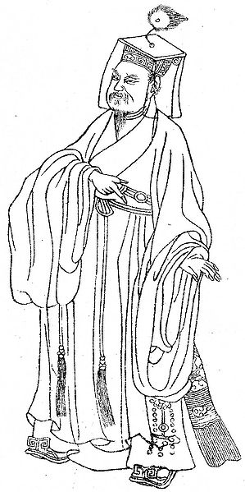
Han Yü 韓愈(768-824)
High official, known as a political and cultural reformer. Han was the self -proclaimed “savior” of Confucius and the “patron saint” of later Neo-Confucians.
Han Yu contended that a scholar was like a fine horse that required good care to flourish. (Horses hereafter became a popular image among Confucian scholars for loyal government service.)

Slide 11
Tang Decline
“Cleared the deck" for future developments.
Aristocracy largely eliminated: after the Tang, opportunities open to everyone through the examination system and relied on knowledge of Confucian classics.
Economy on the mend; trade up.
Confucianism began to take off!

